Slide 1
ED Outcome Prediction Using MIMIC-IV Data
Group 2
Chen Yiman
Kwa Kah Boon
Neo Yi Xin
Shi Chee Liang
Tan Zexeong (Joseph)
Yogendra Sunil Shinde
Zhu Fangyuan
Zhu Yiting

Slide 2
Abstract & Project management
Objectives:
To develop and validate models to predict (1) Hospital Admission, (2) Critical Outcomes, and (3) 72-hour ED Readmission. The results would be compared to the sample codes provided under ISSS623 (Jul, 2023) as baseline.
Method:
Apply various Machine Learning (ML) algorithms on prepared datasets extracted from MIMIC-IV-ED, ICU and HOSP. To enable results comparison, the same algorithms (Logistic Regression, Random Forest, Gradient Boosting, Multilayer Perceptron) as the sample codes are applied and additional algorithms (CatBoost, eXtreme Gradient Boosting) are experimented for some tasks.
Findings:
Task 1 - CatBoost Classifier yielded the best results with AUROC and AUPRC scores of 0.835 and 0.810 respectively.
Task 2 – XGBoost gave the best results, with the highest sensitivity of 0.885 and AUROC of 0.953.
Task 3 – Gradient Boost performed the best in terms of AUPRC and sensitivity at 0.146 and 0.682 respectively.
Task organisation:
The scope and nature of the project necessitated the team to organize ourselves into outcome-based groupings rather than process or categorical based groupings (refer to table)
The team established a common base dataset by the 2nd week before splitting up into independent work groups for the respective tasks. The whole team met once a week to check on progress and share best practices (e.g. usage of AutoML, standardization approaches and selection of evaluation metrics)
Tasks | Assignment
Coordination | Chee Liang
Initial Data Wrangling / Feature Engineering (Week 1 & 2) | Chee Liang, Joseph & Yiting
Task specific data wrangling, Model Training & Evaluation (Week 3 – 6) Task 1: Hospital Admission Task 2: Critical Outcomes Task 3: ED Readmission | Kah Boon & Yi Xin Joseph, Yiting & Yogendra Fangyuan & Yiman
Dashboard Development and Report / Slides (Week 6) | Respective Tasks

Slide 3

Dataset
Data Preparation | Hospitalisation | Critical Outcomes | 72h ED Revisit
Medical Information Mart for Intensive Care (MIMIC)-IV Dataset
Healthcare institution: Beth Israel Deaconess Medical Center (BIDMC)
Patients admitted to: Emergency Department, Hospitalised & Intensive Care Unit (ICU)
Data: Deidentified demographics and clinical data
Period: 2008-2019
120 columns
MIMIC-IV Modules
Feature Categories (x)
Target Variables (y)
Demographic data
Chief Complaints
Outcome Hospitalisation
ED
Master_dataset_2
Hospitalisation data
CCI data
449k rows
ICU
ICU data
Outcome Critical
ECI data
Past & revisit data
Hosp
Other Composite Scores
Outcome ED revisit 3D
Triage attributes

Slide 4
Initial Data Preprocessing
Data Preparation | Hospitalisation | Critical Outcomes | 72h ED Revisit
Aim:
The aim of the initial data preprocessing was to create a common baseline dataset for all 3 tasks to work on. This is due to the project having 3 distinct outcomes having different requirements. Respective tasks went on to apply further processing specific to their tasks.
Initial dropping of features (Principles)
1) Metadata are that were not relevant in the ML tasks were dropped
e.g. index, subject_id, hadm_id, next_ed_visit_time_diff_days
2) Datetime series that featured Anchor years were dropped as they introduced inconsistencies between some similar variables like age and anchor age
e.g. anchor_age, anchor year
120 Features
3) Poor quality Data. Race was dropped even though it is a potentially valuable feature as it consisted of over 30% missing data and around 20% overlaps in the remaining 70%.
4) Interim data that were created to produce transformed features were dropped
e.g. time_to_icu_transfer, next_ed_visit_time
96 Features
*Note that we are highlighting the principles with examples. Not all dropped features are listed. For full features, please refer to the notebook

Slide 5
Initial Data Preprocessing
Data Preparation | Hospitalisation | Critical Outcomes | 72h ED Revisit
Initial data cleaning and corrections
1) Treating Boolean Columns
Many ML Models only work with Numerical values
2) Removal of Outliers
Most outliers were found in Triage values. We created two datasets, one with imputed values (via helper function) and one with dropped rows for experimentation
4) Correction of Erroneous entries
The team noticed erroneous entries between ED & Hospitalisations (duplications). The duplicates were dropped and only the latest entry was kept. Some entries also had incorrect prior ICU stay counts. prior_ICU_stay was recomputed
Heartrate
(outliers)
790
1128
…
Heartrate (imputed)
median median
…
Outcome Hospitalisation (Boolean)
True or False
Outcome Hospitalisation (Numeric)
1 or 0
subject_id
1000032
1000032
stay_id
33258284
39399961
Hadm_id
29079034
29079034
All outliers imputed with median values
3) Converting features to correct data type for ML
Many ML Models only work with Numerical values
Different stay_id with same hadm_id. Suspected that the hadm_id was added retrospectively to earlier ed entries that did not result in hospitalisation
subject_id
11977439
11977439
stay_id
31728560
39437049
n_Icu_30d
1
1
Gender
M or F
Numeric
1 or 0
1st entry should be 0
*Note that not all cleaned features are shown, for full list, please refer to the notebooks

Slide 6
Initial Feature Engineering
Data Preparation | Hospitalisation | Critical Outcomes | 72h ED Revisit
Initial Feature Engineering
1) Date Time Series
Experimented with converting to ‘day of week’, ‘time of day’.
2) Binning (based on NIH (US) age bins)
For category reduction. Note that respective tasks also experimented with other age bins
Age
25
35
30
76
64
…
Age
Young adults
Middle-Aged Adults
Young adults
Elderly
Older Adults
…
Intime_ed
23/5/2171 7:18:00 pm
24/5/2171 11:59:00 am
Day of week Time of day
2 1918 (24hrs)
3 1159 (24hrs)
3) One-Hot encoding for categorical Features
Many ML Models only work with Numerical values
4) Handling of NaN
We created two datasets, one with imputed values and one which dropped the NaN values for experimentation. Imputation was done with either Median values of the feature or KNN
insurance
Medicaid
Medicare
Others
Medicaid Medicare Others
1 0 0
0 1 0
0 0 1
train_drop.csv
test_drop.csv
Age Insurance (Vitals)
24 NaN 123
NaN Medicade 234
75 Medicare NaN
train_impute.csv
test_impute.csv
Imputation was done after splitting into train test to prevent data leakage
Further Feature Engineering and Feature selection were carried out subsequently in the respective tasks

Slide 7

Data Preparation | Hospitalisation | Critical Outcomes | 72h ED Revisit
[Task 1] Hospital Admission Prediction
Congestion and long waiting time in Emergency Department (ED)
In addition to ever-increasing demand, a common cause of ED congestion and delay is the lack of available beds in the hospital for admitted patients. When patients have to stay in the ED after being admitted, they occupy space and resources that could be used for new arrivals. This leads to overcrowding and longer waiting times in the ED.
How can data analytics help?
An accurate hospital admission prediction model could:
Benefit ED patients in reducing their length of stay and improving the quality of service
Help hospital administrators manage the bed coordination process more effectively between ED and the impatient units and optimise the resource allocation for ED patients.
Allow hospitals to gain insights on the type and numbers of patients that visit the ED
Our Machine Learning (ML) Task
There are existing ML models that predict hospital admissions for patients in ED. Our goal is to develop binary classification models that can more accurately predict hospital admission for patients in ED, using administrative, basic demographic and minimal clinical data that are collected at the initial triage assessment.

Slide 8
Literature Review
Data Preparation | Hospitalisation | Critical Outcomes | 72h ED Revisit
predictive model, achieving AUROC values between 0.75 – 0.92, and Gradient Boosting comes in second with 10 out of 14 using either one of these algorithms for prediction.
Closer to home, in an observational study by Parker, et al. 2019 over a 10-year period, the authors revealed that
The wait time at Singapore's largest hospital (SGH), from admission to ward, ranges from 1 to 7.9 h on a given day. Improving flow from the ED to the admitting ward could have powerful effects on reducing overcrowding.
Eight variables - age group, race, postal code, day of week, time of day, triage category, mode of arrival, and fever status - were included in their final model. Increasing age, increasing triage acuity, and mode of arrival via private patient transport were most predictive of the need for admission.
The Logistic Regression model achieved an
AUROC of 0.825 (95% CI: 0.824–0.827) with
sensitivity of (0.775; 95% CI: 0.772–0.777) and specificity (0.748; 95% CI: 0.746–0.750) at the optimal threshold probability for “admitted” class of 0.425.
In a separate analysis, using data from a major hospital in a metro area in the United States with an approximately 50,000 ED visits per year (Araz et al. 2019), the auditors experimented with Logistic Regression, Artificial Neural Network, Decision Tree, Random Forest, Support Vector Machine and Extreme Gradient Boosting to predict hospital admissions.
Extreme Gradient Boosting algorithm (or XGBoost) gave the highest AUROC statistic, and it stood out as one of the fastest algorithms. However, a less sophisticated model, such as simple logistic regression model, also performed well in a reasonable computational time. With XGBoost, age category and acuity level were identified as the most important predictors of admissions from the ED.
A systematic review of 14 earlier hospital admission prediction studies (Larburu, Azkue, & Kerexeta, 2023) examined the variables used, summarised the algorithms and performance of these admission predictive models. The study found that:
(i) 6 categories of variables - demographics, triage information, clinical findings, medical history, medication and others – were used for prediction with Age and ED triage category being the two most used variables.
(ii) AUROC is the common model performance evaluation metric used across all studies. This is followed by Accuracy which was used in 2 studies.
(iii) Logistic Regression is the most used
8

Slide 9

Workflow and Experiments
Data Preparation | Hospitalisation | Critical Outcomes | 72h ED Revisit
Feature Selection &
Engineering
Data Spiltting, Encoding & Scaling
Model Development and Tuning
Model Evaluation
Excluded:
Features that were not relevant or available at the triage
Features that are highly correlated to others based on Multivariate Analysis
Included:
Features such as hour_of_ed_visit and age_binned which appeared relevant based on Univariate Analysis
Split data into X_train, y_train, X_test, y_test
One-Hot Encoding for Categorical Variables
Feature Scaling for Numerical Variables:
Standardisation
MinMax Scaling
Robust Scaling
Select high performance classifier with the aid of AutoML package (PyCaret)
Performed model fitting on variations of the train sets
Performed 5-fold cross-validation to find best hyperparameters using GridSearch, RandomisedSearch and Optuna
Chose evaluation metrics in line with the study’s objective
Compared model performance using the chosen evaluation metrics
Understood feature importance from baseline and top two models
Experimented with: Customised CCI Score by adjusted the weights of each CCI condition | KNN imputation for missing triage_acuity values Retained missing 'Triage_acuity' rows and dummy coded this column | Used SHAP to interpret the important features of MLP model

Slide 10
Results – Model Comparison
Data Preparation | Hospitalisation | Critical Outcomes | 72h ED Revisit
Model | Threshold |  |  | AUROC |  |  | AUPRC |  |  | SENSITIVITY |  |  | SPECIFICITY |  |  | TRAINING TIME (seconds)
 | Benchmark | Full Features | Best Model | Benchmark | Full Features | Best Model | Benchmark | Full Features | Best Model | Benchmark | Full Features | Best Model | Benchmark | Full Features | Best Model | Benchmark | Full Features | Best Model
LR | 0.443 | 0.452 | 0.445 | 0.806 | 0.814 | 0.814 | 0.774 | 0.783 | 0.783 | 0.746 | 0.746 | 0.755 | 0.718 | 0.729 | 0.722 | 6.074 | 5.159 | 20.138
RF | 0.484 | 0.500 | 0.489 | 0.819 | 0.820 | 0.825 | 0.790 | 0.788 | 0.799 | 0.758 | 0.745 | 0.758 | 0.728 | 0.741 | 0.736 | 71.495 | 97.808 | 99.694
GB | 0.483 | 0.497 | 0.484 | 0.819 | 0.818 | 0.827 | 0.796 | 0.791 | 0.802 | 0.747 | 0.737 | 0.751 | 0.732 | 0.741 | 0.745 | 67.668 | 108.119 | 287.404
MLP | 0.445 | 0.460 | 0.526 | 0.822 | 0.816 | 0.825 | 0.800 | 0.787 | 0.800 | 0.751 | 0.747 | 0.752 | 0.738 | 0.734 | 0.739 | 48.636 | 749.615 | 182.499
CB | NA | 0.480 | 0.472 | NA | 0.830 | 0.835 | NA | 0.805 | 0.810 | NA | 0.760 | 0.746 | NA | 0.743 | 0.762 | NA | 50.284 | 207.35
Best Performing Model
LR: Logistic Regression, RF: Random Forest, GB: Gradient Boosting, MLP: Multi-Layer Perceptron, CB: CatBoost
The Full Features approach is a method of applying the ML algorithm (with default hyperparameters) on a dataset that has been preprocessed with all relevant features that are available at the triage, MinMax scaling and one-hot encoding. The modelling outcomes of this approach varied, with LR and RF outperforming the benchmark scores, while GB and MLP fell short of the benchmark.
​
After hyperparameter tuning, the best model results for LR, RF, GB & MLP all achieved slightly better results than the benchmark results in terms of AUROC, AUPRC, Sensitivity and Specificity. The
best performing model was obtained using the CatBoost Classifier, found from our experiment with PyCaret, which yielded AUROC, AUPRC and Specificity scores of 0.835, 0.810 and 0.762 respectively.​
The tuned Logistic Regression Model would be a good choice if a fast runtime is more important than the prediction accuracy. It can be trained in less than 30 seconds with an acceptable 2%-point drop in AUROC and AUPRC scores. The Logistic Regression model is also straightforward to interpret and clearly
articulates how different factors contribute to the prediction.

Slide 11
Results – Feature Importance
Data Preparation | Hospitalisation | Critical Outcomes | 72h ED Revisit
Top 10 Important Features
The Charlson Comorbidity Index (score_CCI) is strongly influenced by age. Our analysis shows that age/score_CCI and triage_acuity are the top 2 most important predictors of hospitalization in all three models. This is in line with our literature review that identified Age and ED triage category as the most common factors used for hospitalization prediction. We also found that triage readings and prior admissions have a significant impact on the admission outcome for the current visit.
Interestingly, the two tree-based models do not really share similar important features as the Logistic Regression for the same prediction task.
We also observed that some additional features (marked with *), which were not included in the original code example, appeared among the top 10 features. Hence, it’s usually worthwhile to experiment with new features to see if they improve model performance.
Common feature in at least 2 of the models

Slide 12
Discussion
Data Preparation | Hospitalisation | Critical Outcomes | 72h ED Revisit
Assumptions
Prediction takes place at the triage and that all variables used in the models are accurate and available at the point of prediction.
Insurance information was collected upon hospitalization and unavailable at ED triage. Thus, this variable was not used for our ML task as it results in data leakage.
Future work on Hospital Admission Prediction
Consider including other features such the length of stay at the hospital/ICU/ED, textual data from clinical notes and discharge summaries from prior visits, or even environmental variables (for e.g. air pollution index) in future models that could be associated with hospital admissions.
Consider evaluating the use and accuracy of additional machine learning algorithms against the models presented in our endeavor. This could include combining multiple algorithms into an ensemble to enhance prediction accuracy. Pycaret has additional features to automate tasks such as model blending and stacking.
A possible way to improve the deployment of the model prediction for hospital admission is to link it with the real-time bed occupancy data. This would allow the system to trigger an alert when more beds are needed to accommodate the projected increase in patients being admitted.
Collaborate with domain experts to research into a golden standardized clinical scoring metric, that is aligned with patient-oriented outcomes, for hospital admission.
Consider using the modes in performance monitoring and audit by comparing predicted admissions against actual admissions. However, while the model could be used to support planning and decision making, individual level admission decisions still require clinical judgement.
Possible reasons for modelling results
We only attained a 1.3%-point improvement in AUROC and a 1.0%-point improvement in AUPRC from the benchmark results despite adhering to the recommended practices for the data modelling. Some possible reasons for the marginal improvements in modelling performance could be:
The data did not adequately capture the temporal or seasonal patterns (such as seasonal diseases like influenza) in hospital admissions, since the dates were shifted to anonymize the patients.
The benchmark model was already well-optimized and robust, leaving little room for improvement. CatBoost, our best performing algorithm, is a variant of the gradient boosting on decision trees which is one of the benchmarked models.
The modelling practices we applied were not suitable or effective for this specific problem domain or data set.

Slide 13
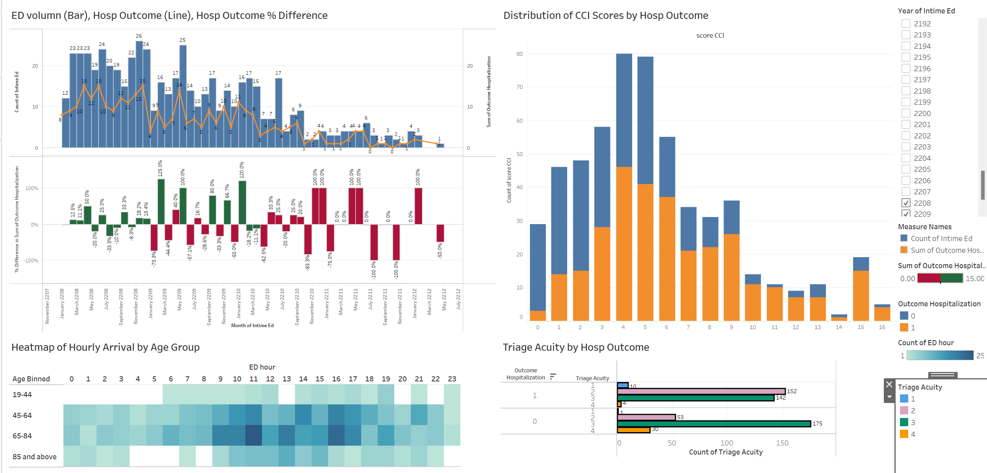
Dashboard (Hospital Admission)
Data Preparation | Hospitalisation | Critical Outcomes | 72h ED Revisit
Purpose: Monitor the important variables contributing to hospital admission, helping the managers to make decisions.
Filter the period of ED admission by year
Monitor monthly trend of ED admissions, number of hospital admissions and its change from previous month
Monitor the CCI Score distribution, segmented by hospitalization outcome
Monitor the hourly arrival of ED patients by age group - for manpower allocation
Monitor the distribution of triage acuity categories by hospitalization outcome
Note:
To improve the dashboard's usefulness, we should include resource information such as the staff availability and bed occupancy rate in real time. This way, we can compare admission predictions to the resource availability and make better decisions.
We understand that the ED dates (e.g., intime_ed column) have been altered in order to protect the identities of the patients. As a result, the time series chart in the dashboard currently may not accurately reflect the actual statistics.

Slide 14

[Task 2] Critical Outcomes Prediction
Data Preparation | Hospitalisation | Critical Outcomes | 72h ED Revisit
In hospital mortality or transfer to ICU within 12 hours.
To ensure that healthcare providers can prioritise the treatment of high-risk patients promptly and efficiently with limited ED and hospital resources, it is prudent to precisely identify patients at a higher risk of inpatient mortality or intensive care unit (ICU) admission within 12 hours (collectively, critical outcomes). Such actions can be life-saving as there is higher risk of mortality and morbidity when the boarding process to ICU from the ED is prolonged (Henrique, 2022) to beyond 24 hours (Boudi, 2020).
Critical outcomes prediction
Our team aims to use machine learning algorithms to predict critical outcomes for ED patients (binary classification). We will do so at two opportunities:
1. Upon triage – Using patient demographics and triage vital signs data
2. At the end of ED – Layer on latest set of ED vital signs and administrative data (e.g., insurance) as patient’s condition evolves
Evaluation metrics
We focus on sensitivity as the impact of missing out a potential critical outcome patient is more detrimental. Following which, we look at the overall model performance using AUROC in line with most literature.
Source: gorodenkoff / Getty Images

Slide 15
Literature Review
Data Preparation | Hospitalisation | Critical Outcomes | 72h ED Revisit
Jefferey et al. (2022) reported that critical patients had higher body temperature, heart rate and number of prescribed medication than non-critical patients. The study also identified the following features that have strong influences towards outcome:
Age (0.09980)
Triage Systolic BP (0.09978)
Triage Acuity (0.0921)
Triage Diastolic Blood Pressure (0.0838)
Triage Respiratory Rate (0.0567)
Triage Oxygen Saturation (0.0505)
Triage Pain (0.0398)
ED visits within past 365 Days (0.0187)
An interesting finding was that the length of ED stay did not rank high in importance among the features that predicted mortality, contrary to the common understanding that longer ED stays lead to worse outcomes. One possible explanation was that more critical patients were identified upfront by the medical team and prioritised for treatment or transferred to ICU early, leading to shorter ED stays.
AUROC was used as the metric to compare model performance and the Gradient Boosting model had the best performance, with an AUROC of 0.880.
van Klaveren et al. (2021) conducted critical outcome prediction on COVID patients admitted via ED at four large Dutch hospitals using logistic regression as a simple and valid tool. The model achieved 0.79-0.83 AUROC among the four hospitals, with age, respiratory rate, C reactive protein, lactate dehydrogenase, albumin and urea capturing most of the ability to predict in-hospital mortality and ICU admission.
Notably, for ICU admission, the authors noted that the probability decreased with age after the age of 70, likely reflecting the decision not to admit older patients to ICU given bed shortage during the COVID pandemic. Hence, ICU admission after 70 years old was extrapolated using linear regression.
Xie et al. (2017) performed a systematic review on modeling methods for predicting in-hospital mortality of patients in ICU, which compared models including rule-based scoring models, logistic regression, decision tree and artificial neural network (ANN) using AUROC as the comprehensive evaluation metric. Out of 14 studies which satisfy the review requirements, machine learning methods consistently outperformed rule-based models, with 7 out of 10 studies using ANN seeing ANN as the top model with AUROC of 0.857-0.880.
Notes:
Raita Y, Goto T, Faridi MK, Brown DFM, Camargo CA Jr, Hasegawa K. Emergency department triage prediction of clinical outcomes using machine learning models. Crit Care. 2019 Feb 22;23(1):64. doi: 10.1186/s13054-019-2351-7. PMID: 30795786; PMCID: PMC6387562.
Using triage data that is routinely available, Ratia Y et al (2019) developed four machine learning models to predict critical outcomes in the emergency department (ED): Lasso Regression, Random Forest, Gradient Boosted Decision Tree, and Deep Neural Network. They compared the performance of these models with the conventional method of using the Emergency Severity Index (ESI). They found that Deep Neural Network had the highest AUROC of 0.86 [95%CI 0.85–0.87], which was significantly better than the ESI-based model (with AUC 0.74 [95%CI 0.72–0.75]). The most important features identified by the Random Forest model were Ambulance use, Age, Respiratory rate, Pulse Rate and Systolic blood pressure. The authors concluded that machine learning models could assist clinicians in making better triage decisions and improving patient care in the ED.

Slide 16

Workflow and Experiments
Data Preparation | Hospitalisation | Critical Outcomes | 72h ED Revisit
Feature Selection
Data Spiltting & Encoding
Model Development
Model Evaluation
Excluded:
Features that are highly correlated to others based on Multivariate Analysis
Features that were not available at point of prediction
Split data into train and test set on 80/20 ratio
One-Hot Encoded Categorical Variables
Added high performance classifier XGBoost based on literature
Performed model fitting on variations of the train sets (1st vs 2nd Prediction)
Compared model performance using task-specific evaluation metrics
Understood feature importance from best model for 1st and 2nd Prediction
1st Prediction (ED triage)
Features used:
Demographics (age, gender)
Medical history from past visits (important comorbidities, medication and visit counts)
Triage information (vital signs, acuity, pain and composite scores, chief complaint)
2nd Prediction (post-ED)
Additional features used:
Last ED vital signs based on ED chart time
ED length of stay (LOS) and number of medications given
Insurance
VS
Key assumption: Information available for use at the point of prediction, in particular the second prediction, was based on assumptions (e.g. insurance). Need to validate with data source (hospital) based on existing work processes.
Experimentations: 1. Handling of missing data: Drop Impute using median (best performance) Impute using KNN | 2. Using actual age VS age bins Actual age gave better model performance | 3. Using balanced class weights given imbalanced dataset (6.6% positive class) Balanced class weights gave rise to better model performance for logistic regression and MLP models

Slide 17
Results – Model Comparison
Data Preparation | Hospitalisation | Critical Outcomes | 72h ED Revisit
Model | SENSITIVITY |  |  | AUROC |  |  | AUPRC |  |  | SPECIFICITY |  |  | THRESHOLD |  |  | TRAINING TIME (seconds)
 | Benchmark | 1st Pred | 2nd Pred | Benchmark | 1st Pred | 2nd Pred | Benchmark | 1st Pred | 2nd Pred | Benchmark | 1st Pred | 2nd Pred | Benchmark | 1st Pred | 2nd Pred | Benchmark | 1st Pred | 2nd Pred
LR | 0.806 | 0.739 | 0.822 | 0.884 | 0.829 | 0.886 | 0.437 | 0.310 | 0.414 | 0.797 | 0.766 | 0.792 | 0.064 | 0.495 | 0.481 | 5.571 | 5.865 | 6.779
RF | 0.799 | 0.807 | 0.885 | 0.892 | 0.879 | 0.943 | 0.519 | 0.396 | 0.615 | 0.825 | 0.805 | 0.850 | 0.080 | 0.080 | 0.090 | 99.886 | 65.241 | 71.017
GB | 0.813 | 0.809 | 0.878 | 0.900 | 0.887 | 0.945 | 0.543 | 0.438 | 0.633 | 0.823 | 0.805 | 0.855 | 0.063 | 0.070 | 0.080 | 104.985 | 73.499 | 113.293
XGB | NA | 0.812 | 0.885 | NA | 0.894 | 0.953 | NA | 0.451 | 0.673 | NA | 0.816 | 0.868 | NA | 0.005 | 0.006 | NA | 11.632 | 14.442
MLP | 0.820 | 0.816 | 0.883 | 0.902 | 0.889 | 0.946 | 0.539 | 0.434 | 0.629 | 0.814 | 0.800 | 0.954 | 0.085 | 0.486 | 0.489 | 83.562 | 238.945 | 188.831
Best Performing Model
LR: Logistic Regression, RF: Random Forest, GB: Gradient Boosting, XGB: XGBoost, MLP: Multi-Layer Perceptron, 1st Pred: 1st Prediction, 2nd Pred: 2nd Prediction
Recap on evaluation metrics: Sensitivity (Primary) and AUROC (Secondary). Sensitivity helps to understand true positive rate as identifying maximum no. of true cases is critical in this task to save lives.
Overall, XGBoost gave the best results, with the highest sensitivity of 0.885 (ties with Random Forest) and AUROC of 0.953, at the point of 2nd prediction at the end of the ED episode.
The results outperformed the benchmark model using MLP with 0.820 (6.5%-point ↑) and 0.902 (5.1%-point ↑) for sensitivity and AUROC respectively.
Furthermore, XGBoost gave a more balanced AUPRC (0.673), and is relatively quicker to train (14 seconds) compared to the other powerful models used (1-3 minutes for Random Forest, Gradient Boosting and MLP). Higher AUPRC is better as this dataset is imbalanced
For 1st prediction, one observation was that none of the models outperformed the benchmark model
Upon deep-diving, this is due to data inaccuracy in the benchmark dataset (e.g., prior ICU stay counts were incorrect, patients admitted to hospital or ICU before ED)
Unable to do like-for-like comparison due to different pre-processing performed

Slide 18
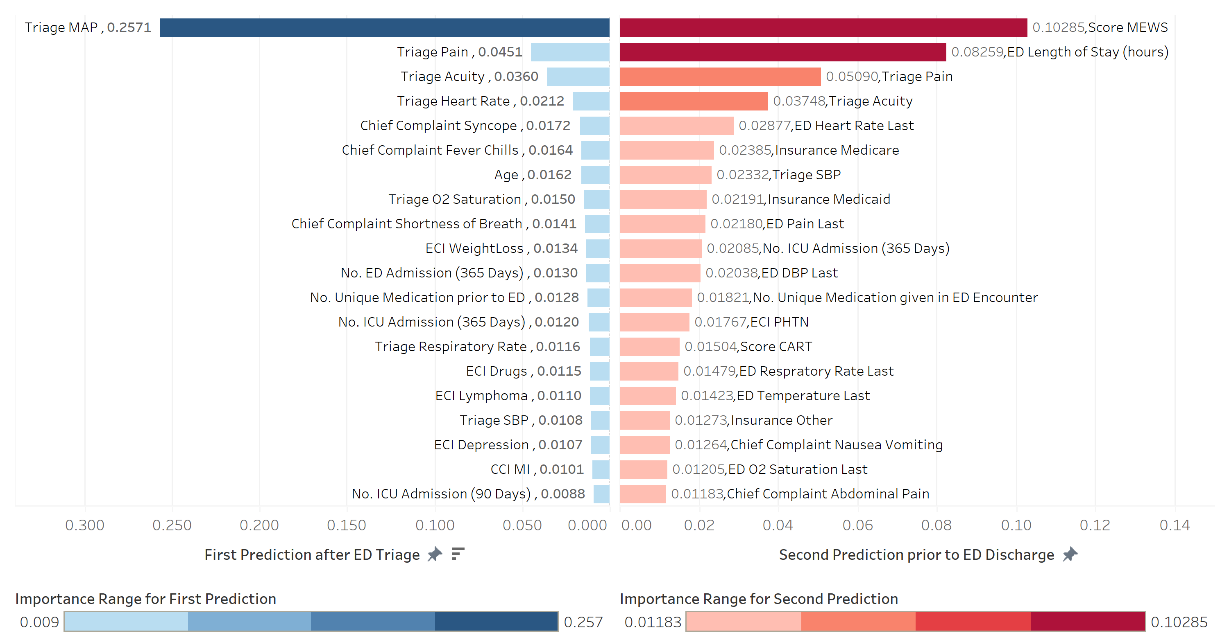
Top 20 Features (XGBoost)
Data Preparation | Hospitalisation | Critical Outcomes | 72h ED Revisit
Both predictions had 1-2 strong predictors (>5% relative feature importance)
Both included composite triage scores (1st Pred: Triage MAP, 2nd Pred: MEWS Score)
Suggests the importance of correctly grouping and interpreting triage values in critical outcomes prediction
On the other hand, comorbidity composite scores did not feature as significantly compared to individual symptoms and diagnoses
7%-point improvement in prediction sensitivity when data about the complete ED stay is available
Key features were ED LOS, last ED heart rate and pain score, insurance
Insurance coverage likely acted as a filtering condition for whether the patient was hospitalised (patients discharged directly from ED will not have critical outcomes by definition)
Triage pain and acuity scores were significant features in both predictions. Hence, it is worthwhile to present the information in a dashboard for the data analytics teams to monitor
Among past visit information, ED and ICU admissions within the past year were particularly important, in line with other similar studies

Slide 19

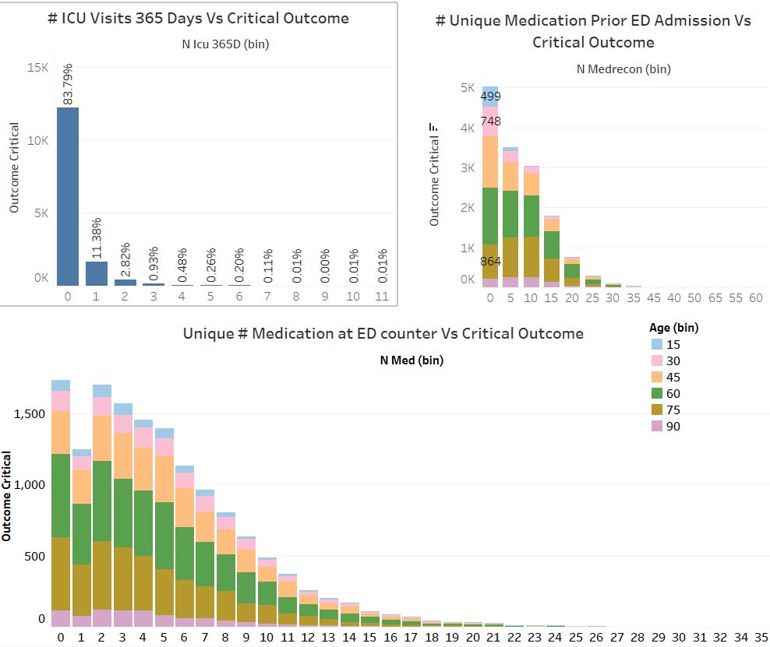
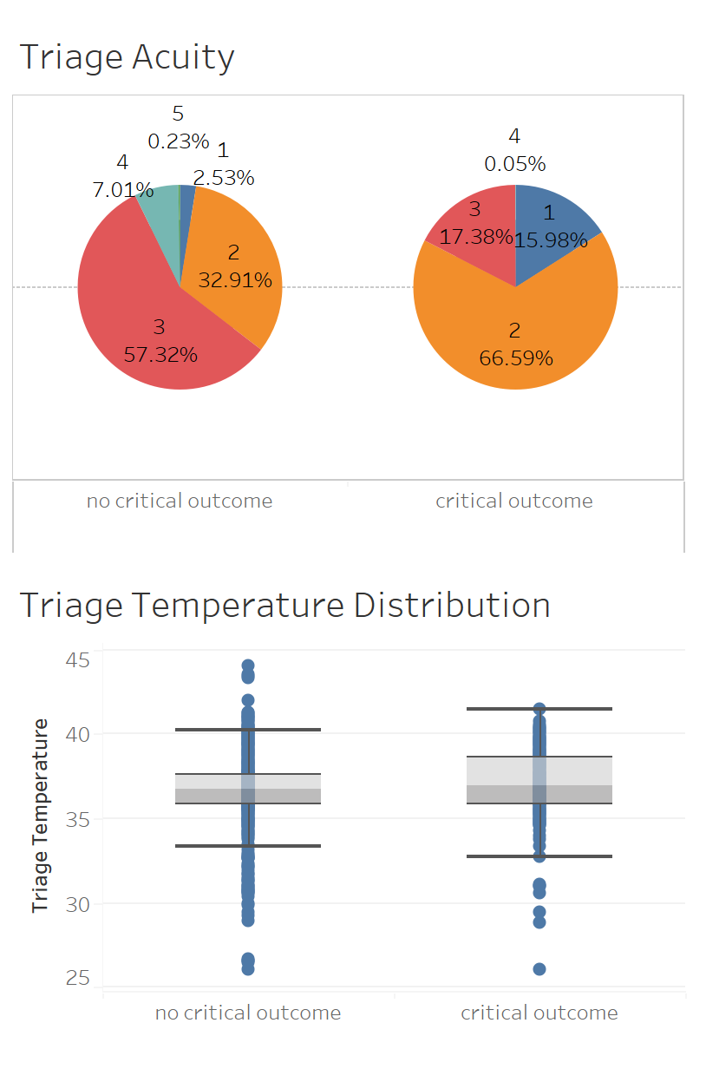


Data Preparation | Hospitalisation | Critical Outcomes | 72h ED Revisit
Purpose – Understand important factors leading to Critical Outcome & distribution of population
Out of 14,560 patients who had critical outcomes,~ 11% had been to ICU once in the last 365 Days.
'Critical Outcome’ was distributed based on number of unique medications in prior ED admissions. The distribution was further sliced on different age bins. Interestingly, the 75–89-year-old group was under-presented in the 0 prior ED medications group.
'Critical Outcome’ was also distributed based on number of unique medications prior to ED admission. This distribution is further sliced on different age-groups. While the number of critical outcomes patients decreases with number of ED medications, there was an anomaly at 1 ED medication.
Target audience: data analytics team to support medical decision-making
Patients with critical outcomes were most likely to have triage acuity of 2 (higher acuity), while acuity of 3 (lower acuity) was more common for non-critical outcomes patients.
Triage temperature was higher on average for patients with critical outcomes

Slide 20
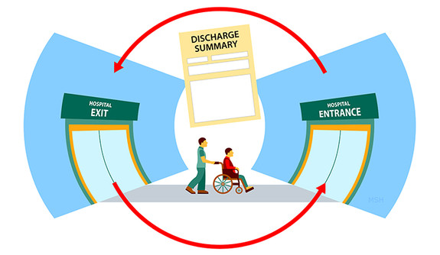
Data Preparation | Hospitalisation | Critical Outcomes | 72h ED Revisit
[Task 3] Predicting ED Readmission within 72hrs
Potential Gaps in Quality of Care and Inadequate Treatment
Patients revisiting the Emergency Department (ED) within 72 hours after initial treatment can indicate potential issues with the quality of care, patient management, or discharge procedures. Frequent revisits not only increase healthcare costs but also suggest that the underlying medical conditions might not have been appropriately addressed during the initial visit.
How can data analytics help?
Analysis of patient data can help identify trends and factors associated with patients who are likely to revisit the ED within 72 hours. These insights can guide healthcare providers in making informed decisions, improving care coordination, and implementing interventions to reduce the likelihood of revisits.
Our Machine Learning (ML) Task
The machine learning (ML) task for predicting patient revisits within 72 hours involves creating a predictive model that takes patient data as input and outputs a binary prediction indicating whether a patient is likely to revisit the ED within the specified time frame. This can be framed as a binary classification problem, where the target variable is whether the patient revisits the ED within 72 hours (1) or not (0). The aim is to build a model that can generalize from the training data to predict revisits accurately.

Slide 21
Literature Review
Data Preparation | Hospitalisation | Critical Outcomes | 72h ED Revisit
Anticipating patient outcomes, including factors like length of stay (LOS) and readmission risk, holds paramount significance within emergency department (ED) contexts. Contemporary healthcare research is progressively exploring the utilization of machine learning (ML) techniques to amplify predictive precision while concurrently upholding model interpretability in the context of ED readmission scenarios.
Artetxe, Beristain & Graña (2018) carried out a systematic literature review of 77 studies which utilized ML techniques in predicting readmission rates. Their research reveals the shift from traditional logistic regression and survival analysis methods towards the growing adoption of ML techniques. Particularly, they found that decision tree-based methods and support vector machines (SVM) emerged as prominent algorithms within this context. However, they also highlighted numerous challenges that make comparisons between such studies challenging. A list of the key challenges are as follows:
Difference in readmission definition –Ranges from 0 days to 1 year (30 days is the most widely used)
Difference in Evaluation Metrics – most studies had AUC scores. AUROC, the standard defacto metric is not always available. Other measures include sensitivity, specificity and PPV
Difference in population studied – There is a wide difference in the population studied in terms of geographical locations, nationality and race.
Focusing on patients with COVID-19, another study by Beiser et al (2021) introduced an ensemble prediction model to identify those at risk of returning to the hospital within 30 days of ED discharge. The ensemble which included classification and regression trees, gradient boosted machines, random forests, and LASSO approaches, exhibit promising outcomes. Their research suggested that ensemble methods may outperform single-tree methods. Essential variables in the studies are oxygen saturation, temperature, and medical history consistently influence the models' predictions. However, it should be noted that this study focused on readmissions related to COVID-19.

Slide 22
Workflow and Experiments
Data Preparation | Hospitalisation | Critical Outcomes | 72h ED Revisit
Iterative
Feature Selection &
Engineering
Data Spiltting & Encoding
Model Development and Tuning
Model Evaluation
Excluded:
ed_death = 1 (can’t revisit)
Iteratively dropped features that are highly correlated to others based on Multivariate Analysis, one by one and evaluate results
Included:
Attempted binning of intime_ed, outtime_ed and age in various formats
Added high performance classifier XGBoost based on literature
Performed model fitting on variations of the train sets
Performed 5-fold cross-validation to find best hyperparameters using GridSearchCV
Compared model performance using the chosen evaluation metrics
Split data into train and test set on 80/20 ratio
One-Hot Encoding for Categorical Variables
Scaling with MinMax Scaler
Experimented with: Imputation vs Dropping NaN Imputation yielded slightly better results | Scaling and Binning Binning of intime_ed, outtime_ed and Age yielded insignificant differences. Same for Scaling | SMOTE and under-sampling SMOTE and under-sampling also resulted in insignificant differences
Ensembles were not experimented with due to time limitations, despite the literature suggesting their superiority.

Slide 23
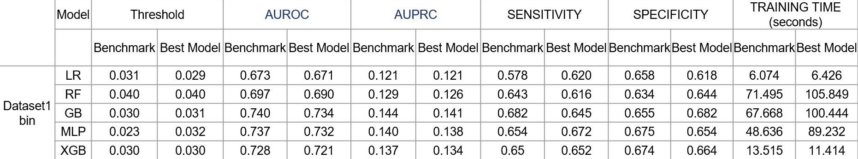
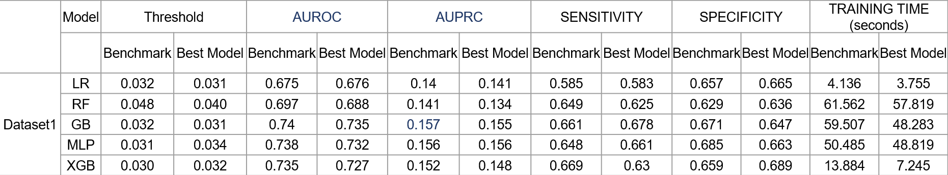
Results of Dropping vs Imputing
Data Preparation | Hospitalisation | Critical Outcomes | 72h ED Revisit
NaN values dropped
NaN values Imputed
The dataset with imputed median for NaN values yielded slightly improved results compared to the dataset with dropped NaN values. However, it's worth noting that a significant portion of the NaN values, around 100k rows, are associated with Triage scores. These values either were initially absent or became NaN after outlier treatment. This introduces a concern when considering the imputed version, as outliers in Triage scores could potentially signal urgent medical conditions demanding immediate attention.
Imputing values to align within the expected range might not offer an accurate representation of the patient's condition for prediction purposes. Outliers in triage scores could hold vital clinical significance and altering them for the sake of imputation might obscure the true urgency of certain cases. This dilemma underscores the need to carefully weigh the benefits of improved results against the potential loss of critical diagnostic information when deciding on the handling of NaN values. Ultimately the team decided to err on the safe side and adopt the dropped dataset for the rest of Task 3

Slide 24
Final Results – Model Comparison
Data Preparation | Hospitalisation | Critical Outcomes | 72h ED Revisit
 | Model | Threshold |  | AUROC |  | AUPRC |  | SENSITIVITY |  | SPECIFICITY |  | TRAINING TIME (seconds)
 |  | Benchmark | Best Model | Benchmark | Best Model | Benchmark | Best Model | Benchmark | Best Model | Benchmark | Best Model | Benchmark | Best Model
Dropped NaN and Scaled | LR | 0.041 | 0.029 | 0.692 | 0.669 | 0.161 | 0.121 | 0.629 | 0.619 | 0.644 | 0.611 | 2.796 | 6.495
 | RF | 0.050 | 0.040 | 0.671 | 0.696 | 0.151 | 0.129 | 0.617 | 0.639 | 0.619 | 0.634 | 36.798 | 106.041
 | GB | 0.039 | 0.030 | 0.704 | 0.740 | 0.167 | 0.146 | 0.621 | 0.682 | 0.665 | 0.655 | 38.576 | 100.340
 | MLP | 0.049 | 0.034 | 0.049 | 0.717 | 0.167 | 0.134 | 0.644 | 0.622 | 0.648 | 0.675 | 18.656 | 89.012
 | XGB | NA | 0.030 | NA | 0.728 | NA | 0.137 | NA | 0.65 | NA | 0.674 | NA | 13.353
Best Performing Model
LR: Logistic Regression, RF: Random Forest, GB: Gradient Boosting, XGB: XGBoost, MLP: Multi-Layer Perceptron
Selected evaluation metrics: AUPRC (Primary) and Sensitivity (Secondary). AUPRC was chosen as it is better suited to evaluate minority outcomes of imbalanced datasets while AUROC performs better for balanced datasets. Keeping in mind that Task 3 outcome is heavily imbalanced with only ~3.4% of the patients being readmitted. At the same time, sensitivity is an important measure to avoid false positives.
Overall: For Task 3, the processed dataset and XGB only yielded minor improvements over the baseline for specific models. One reason could be that crucial data that may necessitate revisit is absent. For example, intuitively a history of chronic illness may be a bigger contributing factor to readmission than a ‘snapshot’ of the patient’s current vital signs at ED admission or ED discharge.
Best Performing Model:
Gradient Boost performed the best in terms of both AUPRC (0.146) and Sensitivity (0.682). The results are slightly better than the baseline in AUROC and Sensitivity but at the same time slightly poorer in AUPRC.
If time is a constraint, either XGB or LR should be selected. LR has the shortest training time, however the results are the poorest. XGB would be a suitable middle ground before the training time becomes much longer.

Slide 25
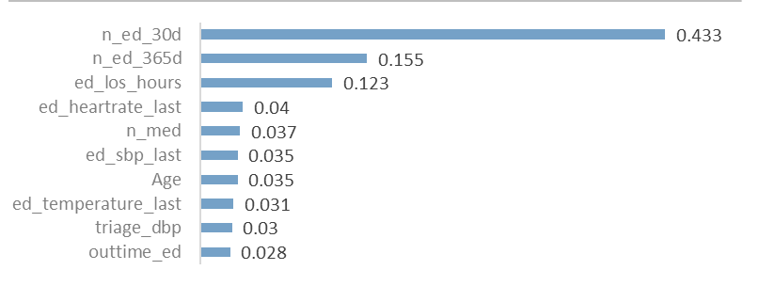
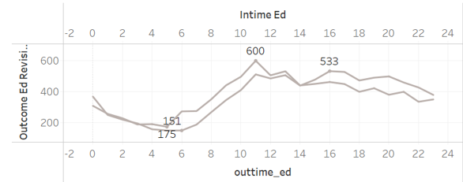
Final Results – Feature Importance
Data Preparation | Hospitalisation | Critical Outcomes | 72h ED Revisit
Top 10 Important Features
The number of revisits within 30 days, 365 days and length of stay in the ED were highly significant indicators for ED revisits within 72hrs. This suggests that patients who revisits the ED are not “one-off” occurrences but have a high tendency to revisit multiple times in the future.
In addition, it was surprising that ed_los_hours was the 3rd most important feature. Upon further analysis, it was found that throughout the day, there is a noticeable peak in the patients who visited the ED between 1000hrs to 1200hrs (figure 2). This further suggests that the hospital may have access to other features (e.g. medical history) that are better predictors for ED_revisits and pushed treatment for such non-critical patients to a later time, causing ed_los_hours to be longer.
It was also interesting to note that patients who had more unique medications are more likely to revisit, This may indicate that the underlying healthcare issue had not been resolved and the hence the patients kept revisiting, receiving a different outcome and medication each time. This would be related to the quality of healthcare.
Figure 1
Figure 2

Slide 26
Discussion
Data Preparation | Hospitalisation | Critical Outcomes | 72h ED Revisit
Assumptions:
The prediction would be done just before ED discharge to assess the risk of readmission.
The current work does not consider the potential bias that may be present in the collection of data, assuming that all data are accurate. This is in part due to the team having no visibility over the collection of data.
Possible reasons for modeling results
The processed dataset and feature selections yielded mixed results when compared with the baseline. Our best model, Gradient Boost’s AUROC and Sensitivity improved but has lower AUPRC. Possible reasons are as follows:
Lack of patient’s medical history. Intuitively, patients with chronic illness would be more likely to revisit than someone that was admitted into ED due to accidents or mishaps. A snapshot of the patient’s vitals at point of discharge is likely to be insufficient in determining if a patient would revisit.
Lack of relevant features. In general, the biggest difference in ML results is often attributed to feature engineering followed by model selection then hyper parameter tuning. If the results are inherently poor across multiple algorithms, it is unlikely that choosing other algorithms or extensive hyper parameter tuning would yield much better results without overfitting. However, for this project the team did not have access to domain expertise to assist in further feature engineering.
Future Work specific to predicting ED Readmission
Explore deeper into the relationship between Length of Stay in ED and ED revisit. Specifically, from the angle of work processes to determine if the ED department was already able to identify such patients and prioritize them for treatment later.
Explore deeper into the relationship between number of unique medications and ED revisit. This is particularly important as a high number of unique medications (>= 25) suggests that the quality of care had been insufficient resulting in the underlying health issue not being resolved and necessitating revisits
Explore narrowing the scope of prediction to selected illness as was done in some studies (e.g. COVID-19). Multiple models could be built for multiple illness.

Slide 27
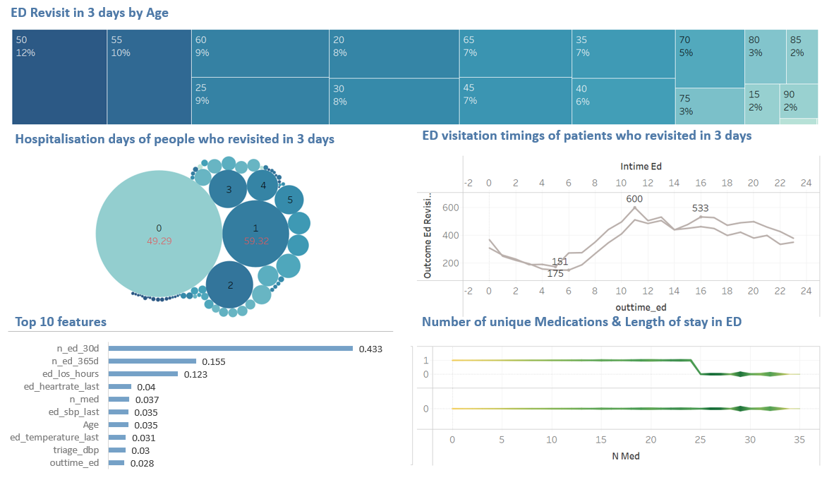
Dashboard (ED Readmission)
Data Preparation | Hospitalisation | Critical Outcomes | 72h ED Revisit
Purpose: Assist the operations managers in making discharge decisions and allocation of resources
Monitor Age group of patients who are more likely to readmit
Monitor Peak visitation timings of patients who revisited
Monitor the the length of hospitalisation for people who readmitted
Monitor key features of patients who are more likely to revisit
Monitor number of unique medications for patients who are more likely to revisit
There’s tooltip in the tableau dashboard
Green = longer stay
Yellow = shorter stay
Note:
For the dashboard to be truly useful, the data shown should be “actionable”, meaning that the data facilitates subsequent decision making. Currently the utility is limited because we do not have a resource view of the hospital, making it more difficult to select the features that have a bigger impact on resource management or cost decisions.

Slide 28
Conclusion
In conclusion, data analytics has emerged as a transformative force in enhancing Emergency Department (ED) processes. By leveraging advanced analytics techniques, healthcare systems can optimize resource allocation, improve patient outcomes, and streamline operational efficiency. Real-time data-driven insights empower medical professionals to make informed decisions swiftly, leading to reduced patient wait times, better resource utilization, and enhanced patient care.
In our research with data modelling for Healthcare analytics.
Gradient Boosting based algorithms, which include Gradient Boost, CatBoost and XGBoost, offer a powerful solution. They have several advantages over more sophisticated models (like the MLP network models in our case) in terms of better performance, interpretability and speed of implementation.
Our data modelling pipeline, which is an improvement over the existing benchmark, could be used as a reference for future ML tasks in an ED setting.
However, it is also important to acknowledge the limitations.
The reliance on historical data might not fully account for unpredictable events, potentially affecting the accuracy of predictions.
The ethical and privacy considerations surrounding patient data usage pose challenges in implementing data analytics solutions.
The possibility of bias in every stage of the analysis from data collection, processing to analysis may potentially affect the accuracy of predictions.
The models may not always be generalizable to every context given that the patient demography and living conditions differs greatly from country to country.
It is also important to keep in mind that healthcare analytics does not replace the trained experts on the ground in making clinical judgements but rather, they serve as another tool that supports the clinical team in making these judgments
In essence, while data analytics holds immense promise in revolutionizing ED operations, a balanced approach that integrates analytics with clinical judgment is crucial to harness its full potential while addressing its inherent limitations.

Slide 29
Future Work
Predictions could be compared to actual patient outcomes to further assess the validity of the models, especially if they are to be applied in Singapore hospitals
Try out ensemble methods to combine best models for better predicative power.
Future work needs to ensure that the ML model can tackle two important challenges viz. Data Drift & Model Drift
Data drift refers to changes in the data distribution that the model is exposed to over time. In other words, the statistical properties of the incoming data change, leading to differences between the training data and the operational data. Data drift can occur due to changes in the data collection process, shifts in user behaviour, or changes in the environment in which the data is collected. Data drift can negatively impact model performance because the model might not be able to generalize well to the new data distribution, leading to decreased accuracy and reliability.
Concept Drift refers to the change in relationships between the input features and the target variable that a model is trying to predict.
Mitigation Mechanism - We may need to consider following steps to ensure that data & concept drift does not erode model performance.
Model Monitoring - Consider various model monitoring tools like Domino, Pachyderm etc. To monitor model performance.
Statistical tests: Use statistical tests like the Kolmogorov-Smirnov test or the Jensen-Shannon divergence to detect changes in the distribution of input data.
Periodic re-training & evaluation: In this method, the model performance is validated after every n number of days/months using newly labelled test data drawn from a recent time period. The model drift can be understood by comparing the performance of the model in the newly drawn test data with older ones.

Slide 30
Thank You Prof Sean
I found the course very insightful on the Singapore healthcare landscape! Never realised the extent of work and thinking that went on behind the scenes. Also, a big thank you to the team for bearing with me – Chee Liang
I’m more aware of biases in healthcare analytics and will be more conscious in the insights generated. Also thankful to my group for making up for my shortcomings. – Yiting
Learned a lot about SG's healthcare system, the challenges of observational studies and the possible bias in the analytics workflow. The project was a valuable chance to learn from my peers and apply new methods in data modelling! – Kah Boon

Slide 31
References [1/2]
Artetxe, A., Beristain, A., & Graña, M. (2018). Predictive models for hospital readmission risk: A systematic review of methods. Computer Methods and Programs in Biomedicine, 164, 49–64. https://doi.org/10.1016/j.cmpb.2018.06.006
Beiser, D. G., Jarou, Z. J., Kassir, A. A., Puskarich, M. A., Vrablik, M. C., Rosenman, E. D., McDonald, S. A., Meltzer, A. C., Courtney, D. M., Kabrhel, C., & Kline, J. A. (2021). Predicting 30‐day return hospital admissions in patients with COVID‐19 discharged from the emergency department: A national retrospective cohort study. Journal of the American College of Emergency Physicians Open, 2(6), e12595–n/a. https://doi.org/10.1002/emp2.12595
Boudi, Z., Lauque, D., Alsabri, M., Östlundh, L., Oneyji, C., Khalemsky, A., Rial, C. L., Liu, S. W., Camargo, Jr, C. A., Aburawi, E., Moeckel, M., Slagman, A., Christ, M., Singer, A., Tazarourte, K., Rathlev, N. K., Grossman, S. A., Bellou, A. (2020). Association between boarding in the emergency department and in-hospital mortality: A systematic review. PLoS One, 15(4):e0231253. https://doi.org/10.1371/journal.pone.0231253
Graham, B., Bond, B., Quinn, M. (2018). Using Data Mining to Predict Hospital Admissions From the Emergency Department. IEEE CCESS.2018.2808843
Hong W. S., Haimovich A. D., Taylor R. A. (2018). Predicting hospital admission at emergency department triage using machine learning. PLoS ONE 13(7): e0201016. https://doi.org/10.1371/journal.pone.0201016
Jeffery, M. M., D’Onofrio, G., Paek, H., Platts-Mills, T. F., Soares III, W. E., Hoppe, J. A., Genes, N., Nath, B., Melnick, E. R. (2020). Trends in Emergency Department Visits and Hospital Admissions in Health Care Systems in 5 States in the First Months of the COVID-19 Pandemic in the US. JAMA internal medicine 180, 1328–1333, https://doi.org/10.1001/jamainternmed.2020.3288
Model Drift. (2023). Domino. URL: https://domino.ai/data-science-dictionary/model-drift
Johnson, A., Bulgarelli, L., Pollard, T., Horng, S., Celi, L. A., & Mark, R. (2022). MIMIC-IV (version 2.0). PhysioNet. https://doi.org/10.13026/7vcr-e114.

Slide 32
References [2/2]
Larburu, N., Azkue, L., & Kerexeta, J. (2023). Predicting Hospital Ward Admission from the Emergency Department: A Systematic Review. Journal of Personalized Medicine, 13(5), 849–. https://doi.org/10.3390/jpm13050849
Li, B., Yue, L., Jiang, J., Chen, W., Li, X., Long, G., Fang, F., & Yu, H. (2022). An Interpretable Machine Learning Approach for Predicting Hospital Length of Stay and Readmission. In Advanced Data Mining and Applications (Vol. 13087, pp. 73–85). Springer International Publishing AG. https://doi.org/10.1007/978-3-030-95405-5_6
Ozgur M. Araza, David Olsona, Adrian Ramirez-Nafarrate (2019). Predictive analytics for hospital admissions from the emergency department using triage information. International Journal of Production Economics Volume 208, February 2019, Pages 199-207.
Parker, C. A., Liu, N., Wu, S. X., Shen, Y., Lam, S. S. W., & Ong, M. E. H. (2019). Predicting hospital admission at the emergency department triage: A novel prediction model. American Journal of Emergency Medicine, 37(8), 1498-1504.
Puls, H. A., Haas, N. L., Cranford, J. A., Medlin, R. P.,, Bassin, B. S. (2022). Emergency department length of stay and outcomes of emergency department-based intensive care unit patients. Journal of the American College of Emergency Physicians Open, 3(1):e12684. https://doi.org/10.1002/emp2.12684
van Klaveren, D., Rekkas, A., Alsma J., Verdonschot, R. K. C. G., Koning, D. T. J. J., Kamps, M. J. A., Dormans, T., Stassen, R., Weijer, S., Arnold, K.-S., Tomlow, B., de Geus, H. R. H., van Bruchem-Visser, R. L., Miedema, J. R., Verbon, A., van Nood, E., Kent, D. M., Schuit, S. C. E., Lingsma, H. COVID outcome prediction in the emergency department (COPE): using retrospective Dutch hospital data to develop simple and valid models for predicting mortality and need for intensive care unit admission in patients who present at the emergency department with suspected COVID-19. BMJ Open., 11:e051468. https://doi.org/10.1136/bmjopen-2021-051468
Xie, J., Su, B., Li, C., Lin, K., Li, H., Hu, Y., Kong, G. (2017). A review of modeling methods for predicting in-hospital mortality of patients in intensive care unit. Journal of Emergency and Critical Care Medicine, 1(2). https://doi.org/10.21037/jeccm.2017.08.03

